Slide 1
DATA ANALYTICS PRESENTATION:
BY:
PHANINDRA PARASHAR
GAURAV KUMAR
VED NERLIKAR
GUIDED BY: PROF. DR. SVEN MÜLLER

Slide 2
TABLE OF CONTENTS:
PROBLEM STATEMENT AND DESCRIPTION
TIMELINE
DATA DESCRIPTION AND EXPLANATION
DATA VISUALIZATION
MODELLING
INTERPRETATION
TAKEAWAYS AND FUTURE SCOPE
REFERENCES

Slide 3
PROBLEM STATEMENT:
Relationship of rent vs purchase prices(multiplier)
Assignment: NN, NN Description ALLMYHOMES is the platform for data-based development and marketing of condominiums located in Berlin, Germany (https://www.allmyhomes.com/category/uber-uns-en/) The project represents actual business problems with strategic relevance for ALLMYHOMES. The findings will support management decisions. We expect (at least): description of chosen data set, including source Explicit formulation of hypotheses (assumptions) Visualization of results (e.g. variable dependencies and trends). Due to the nature of our business model (real estate projects with long transaction cycles), we consciously decided not to supply (limited) internal data but rather let students research and gather relevant and sufficient external data (publicly available on online real estate portals like immobilienscout24.de or neubaukompass.de). By “new development” real estate, we refer to newly constructed projects in Germany built by large property development companies (Bauträger) with at least 10 apartment units (excluding e.g. smaller multi-family homes). ALLMYHOMES are available for questions at any time. Contact: : Gaurav Sing (Director Business Development) & Paul Koeper (Pre-Sales Analyst).
● Context: ○ In recent years the percental increase of German real estate purchasing prices has been considerably higher than the percental increase of rents ○ The Gross Rent Multiplier (Property Price / Gross Annual Rent) is one measurement to describe this relationship ○ Not only has this multiplier increased in the past few year, but it also varies significantly ● How has the multiplier developed in the past? ● Which factors determine the multiplier (i.e. the difference of rent vs purchase prices)? E.g. ○ Building (apartment) Location (ZIP code) ○ Size of apartment (in sqm)
● Which of these micro factors (i.e. variables) correlate with each other, and which (can be isolated to) have the highest impact on price? Potentially discuss/exchange with Topic groups 1 and 2 (see projects above) to investigate major drivers (i.e. independent variables driving macro and micro pricing)
● Bonus: Based on historical data, is there any trend recognizable that could predict future multiplicator patterns?

Slide 4
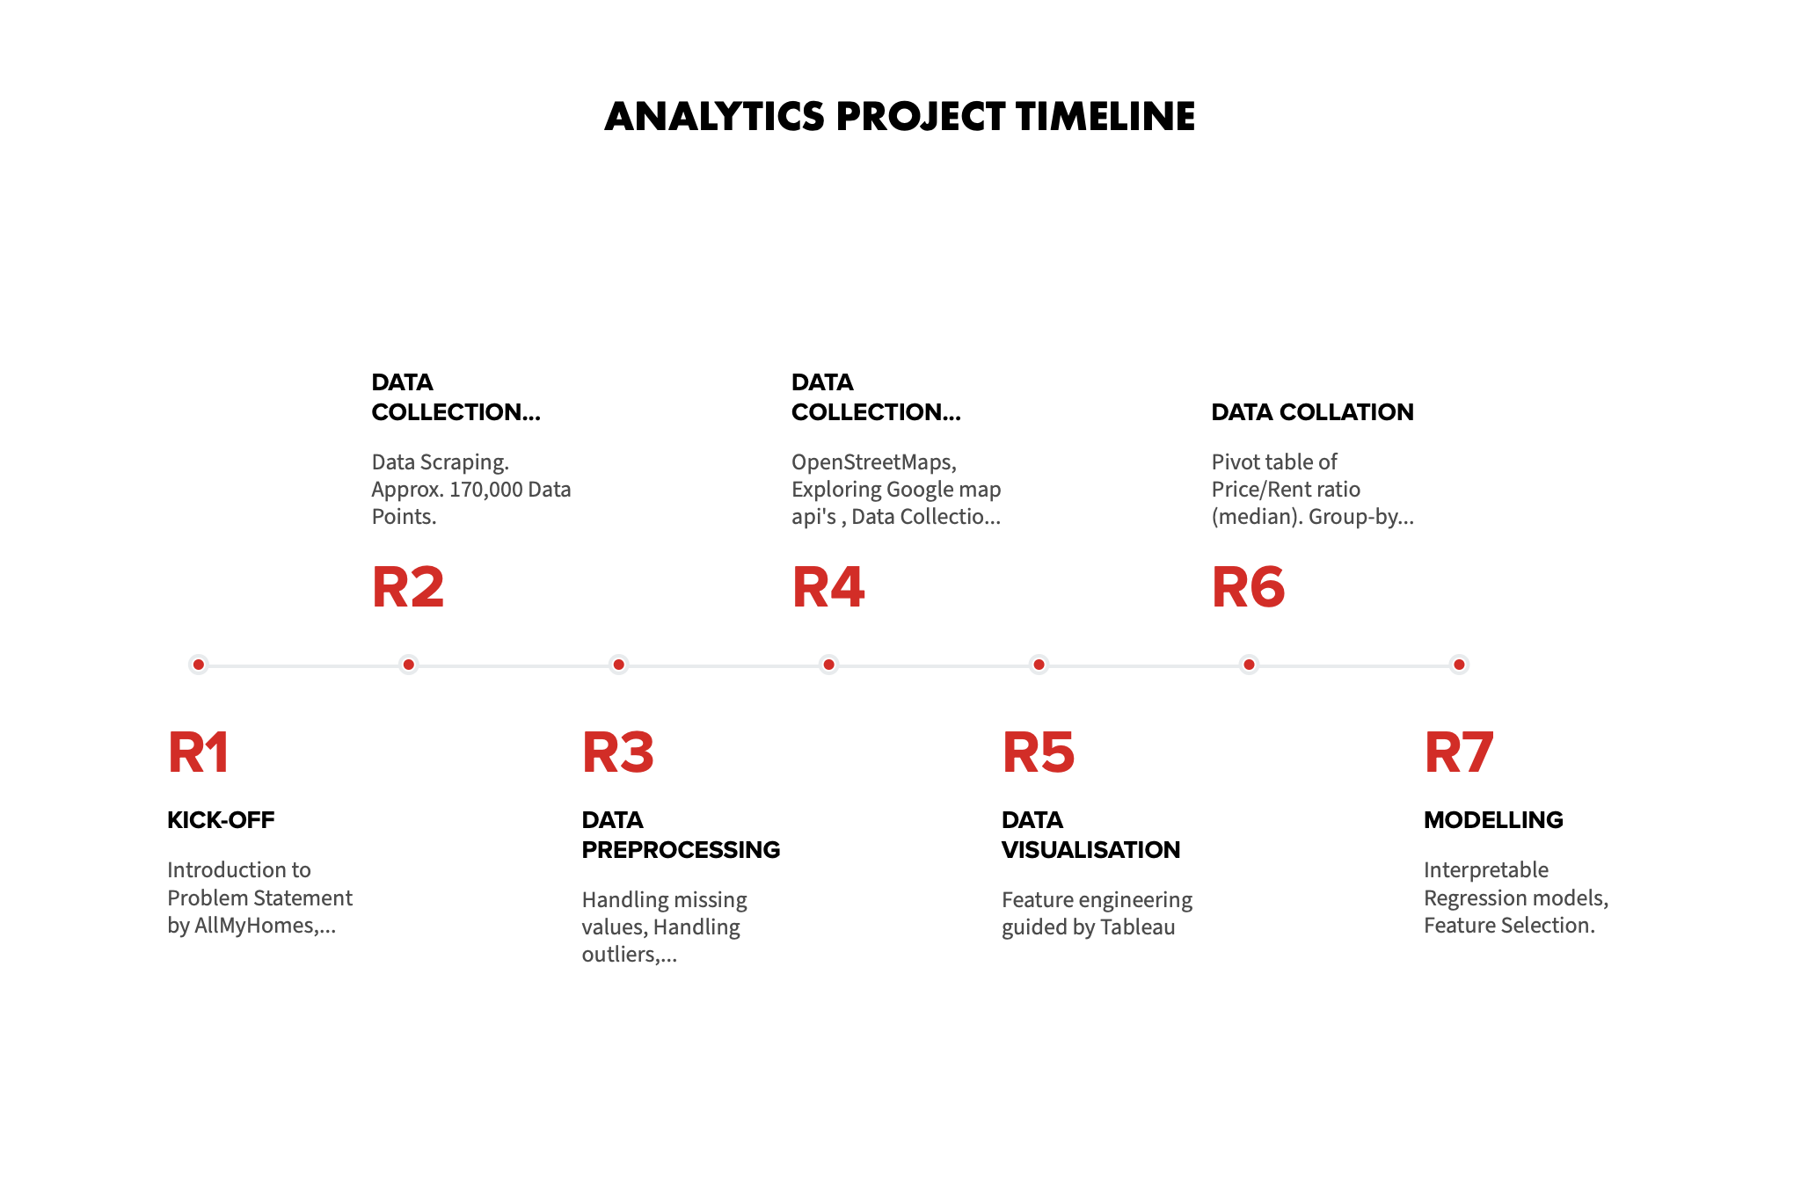
Notes:
Notes:
1)
2) Scraping immobillienscout24 website. Description of data: Approx. 170,000 Data Points of both Purchase and Rental Data.
3) Data preprocessing → Handling missing values, handling outliers, dimensionality reduction
4) Data collection → macro → paid service with google maps api so not chosen therefore chosen openstreetmaps → also collected data from sven
5) Feature engineering guided by visualization
6) Creating relevant data for modelling, grouping by micro and macro features → grouped by building types in the population
7) Interpretable regression modeling and feature selection

Slide 5
Challenges:
Initial misinterpretation of Price to Rent ratio.
Losing most of the micro features during groupby
For micro features we could only preserve living space, number of rooms and age. Because aggregation could only be performed on numerical data.
OpenStreetMap versus Google Maps api
Losing data after merging rental and price data.
Notes:
If using imputation, this would not be true data but artificial data which is why we are concerneced and decided to drop it, although we tried to preserve as much data as possible. Most of the data we collected were not really good for the problem we had → url, country, immobilien scout id etc.

Slide 6
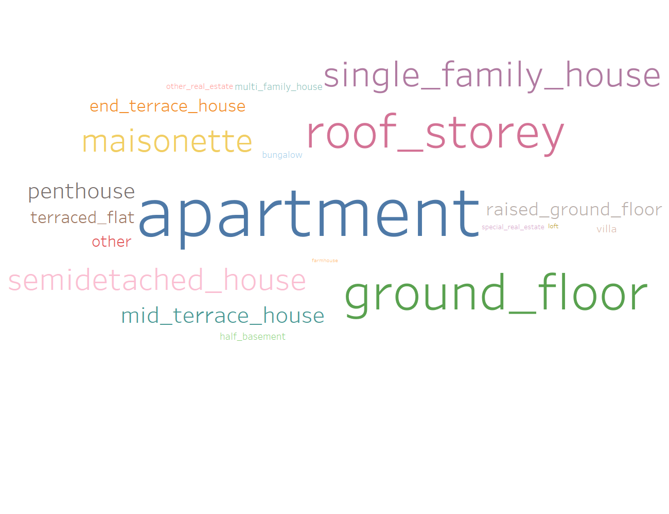
Data Insights:

Slide 7
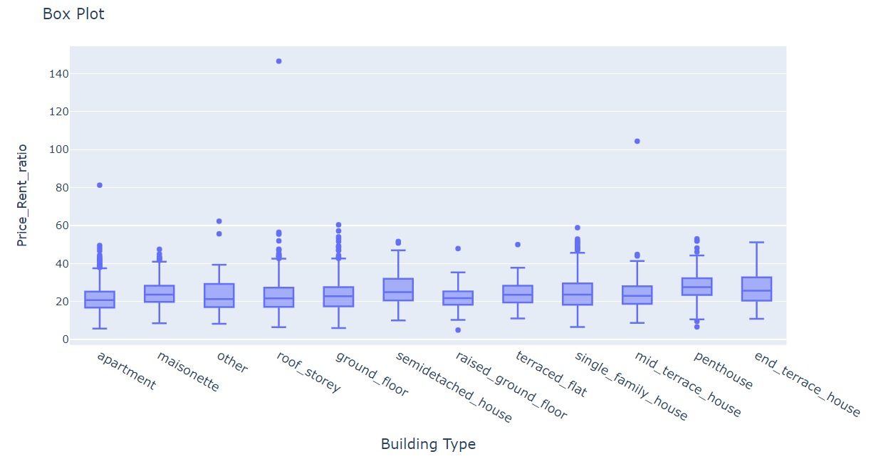
Overview of Price to Rent Ratio VS BUILDING TYPE

Slide 8
Data Preprocessing:
Removing Outliers
Removing unwanted columns which do not have an impact on the model: e.g. Country Name; URL; Time Stamp of data collection
Merging of 2 types of data i.e. Wohnung and Hauskauf: using Tableau Prep
Merging Micro and Macro feature data
Features Engineering

Slide 9
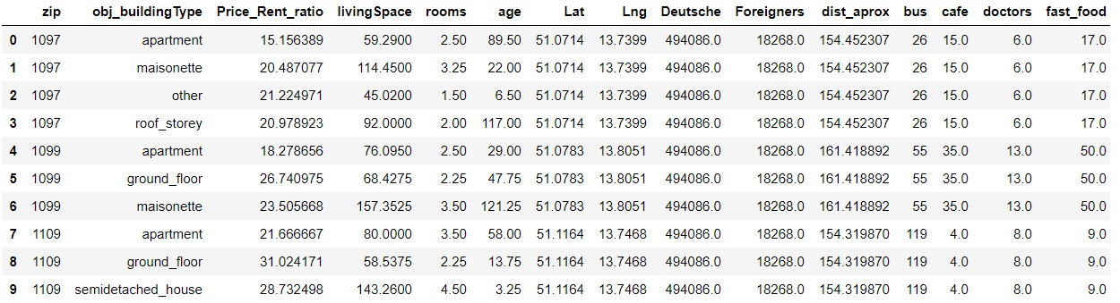
Data

Slide 10
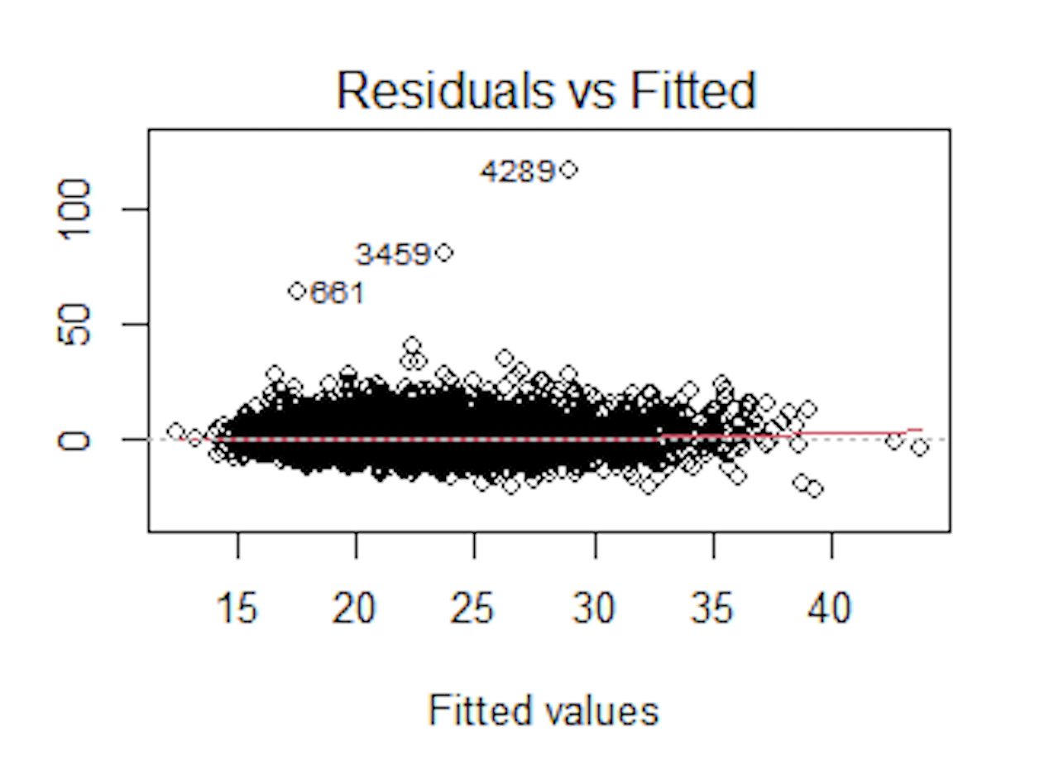
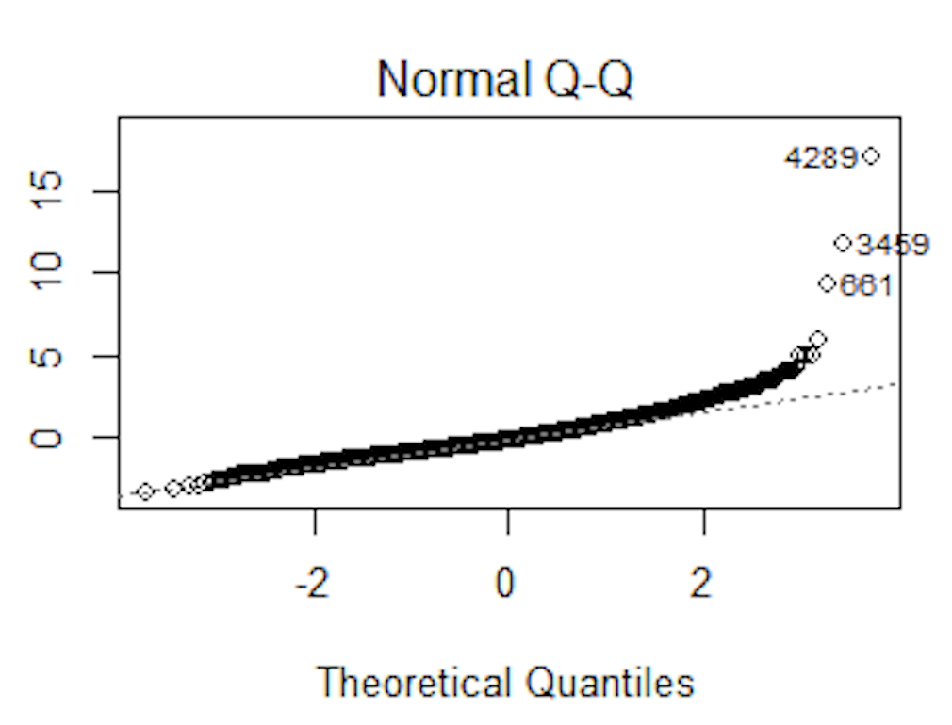
Statistical Analysis
Heteroscedastic Test for variance
Using Residual and Fitted plot
Using Breusch pagan Test
Result : BP = 53.032, p-value = 0.05341

Slide 11
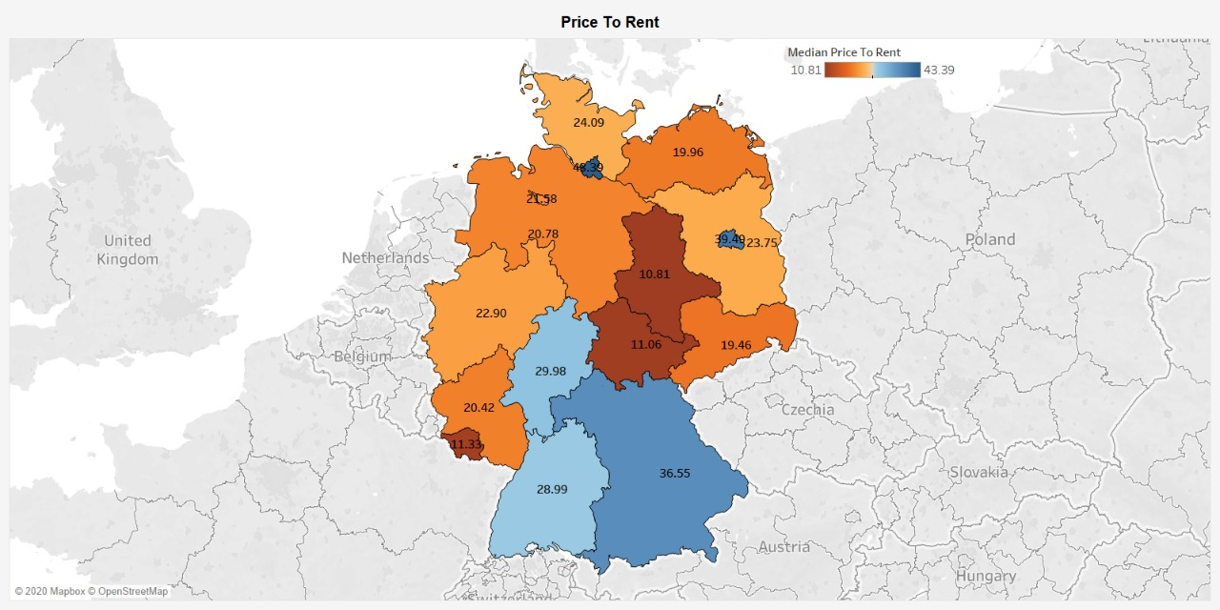
Region-wise visualization
https://public.tableau.com/profile/gaurav.kumar7925#!/vizhome/PriceToRent_15935571642500/Dashboard2?publish=yes

Slide 12
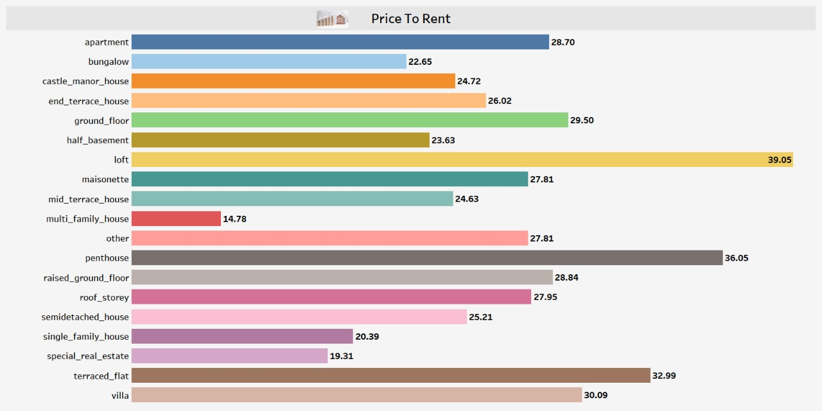
visualization
https://public.tableau.com/profile/gaurav.kumar7925#!/vizhome/PricetoRentBuildingTypes/Dashboard1?publish=yes

Slide 13
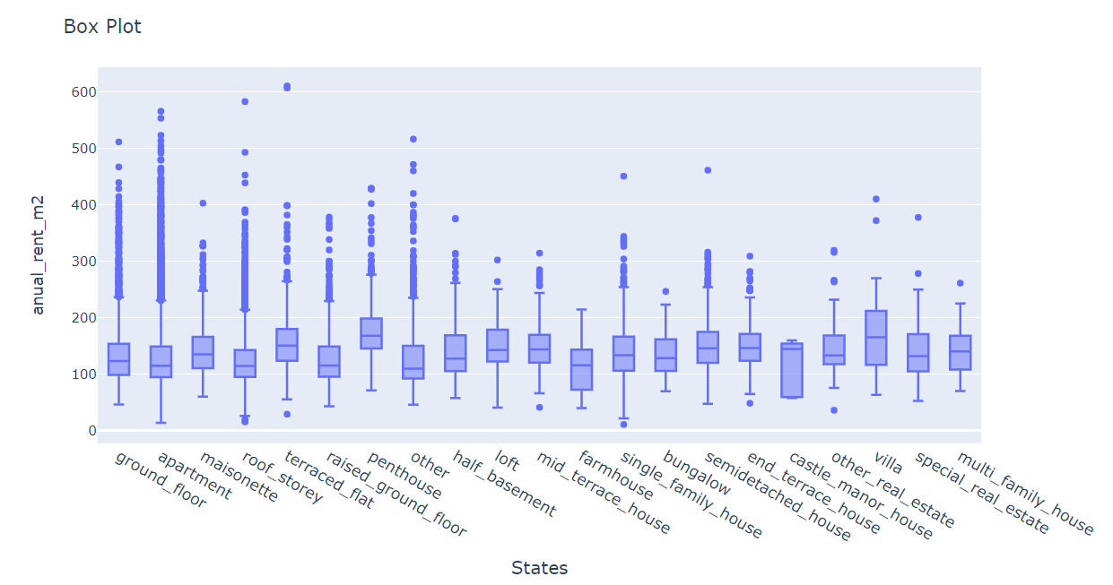

Slide 14
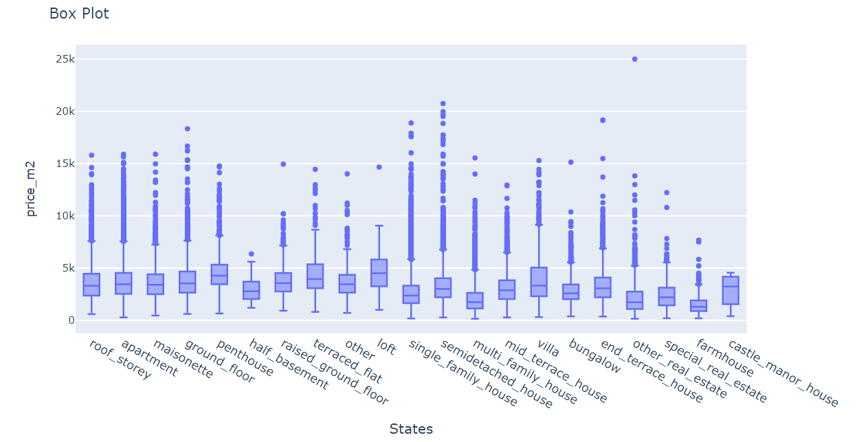

Slide 15
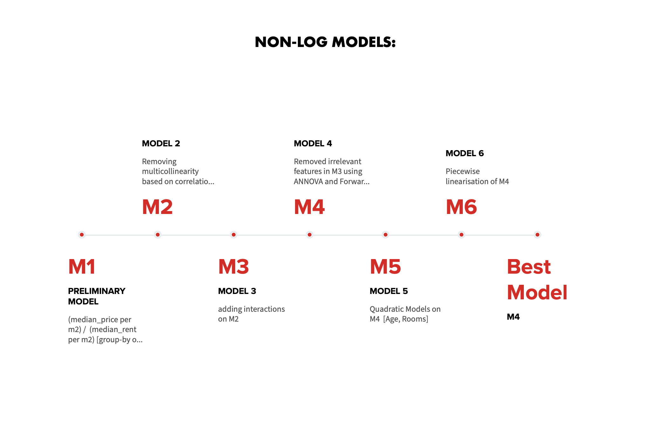

Slide 16
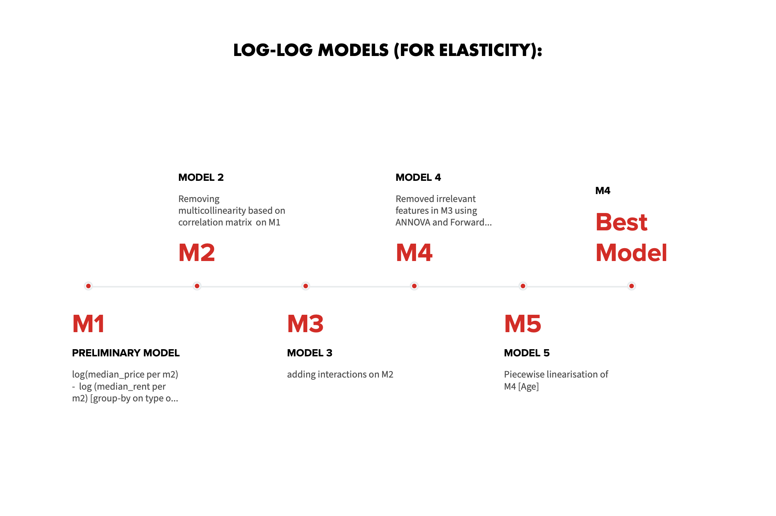

Slide 17
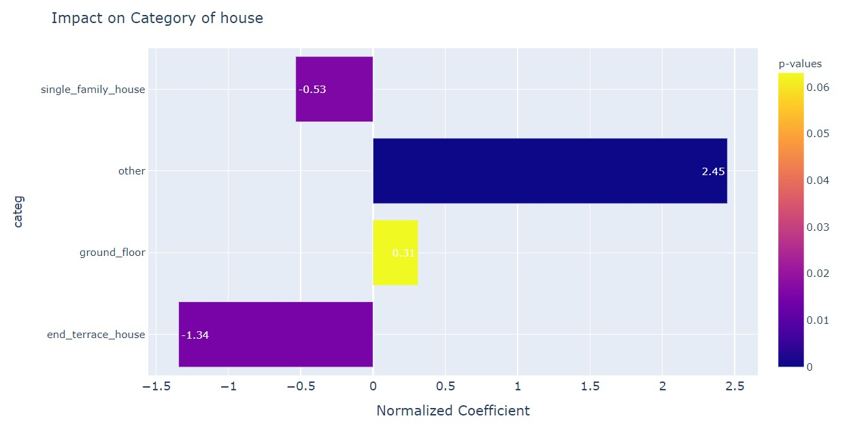
Non-log model: normalized coefficient

Slide 18
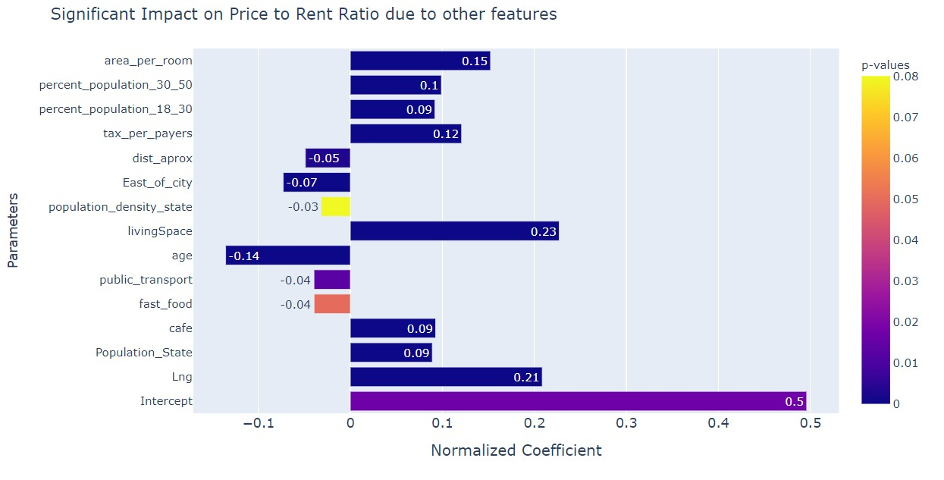
Non-log model: normalized coefficient

Slide 19
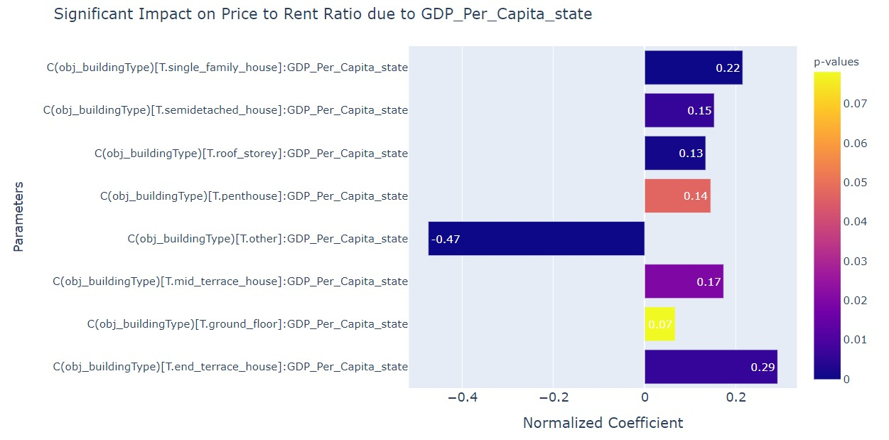
Non-log model: Normalized Coefficients

Slide 20
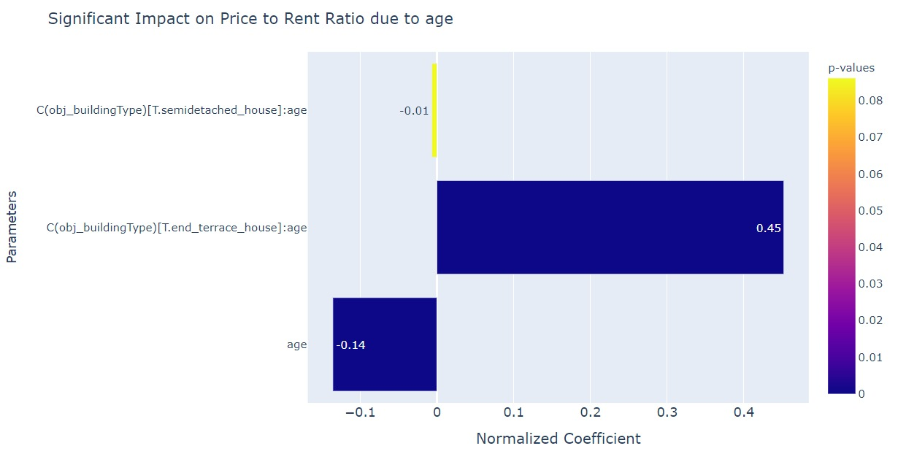
Non-log model: Normalized Coefficients

Slide 21
Interpretation of Log Model

Slide 22
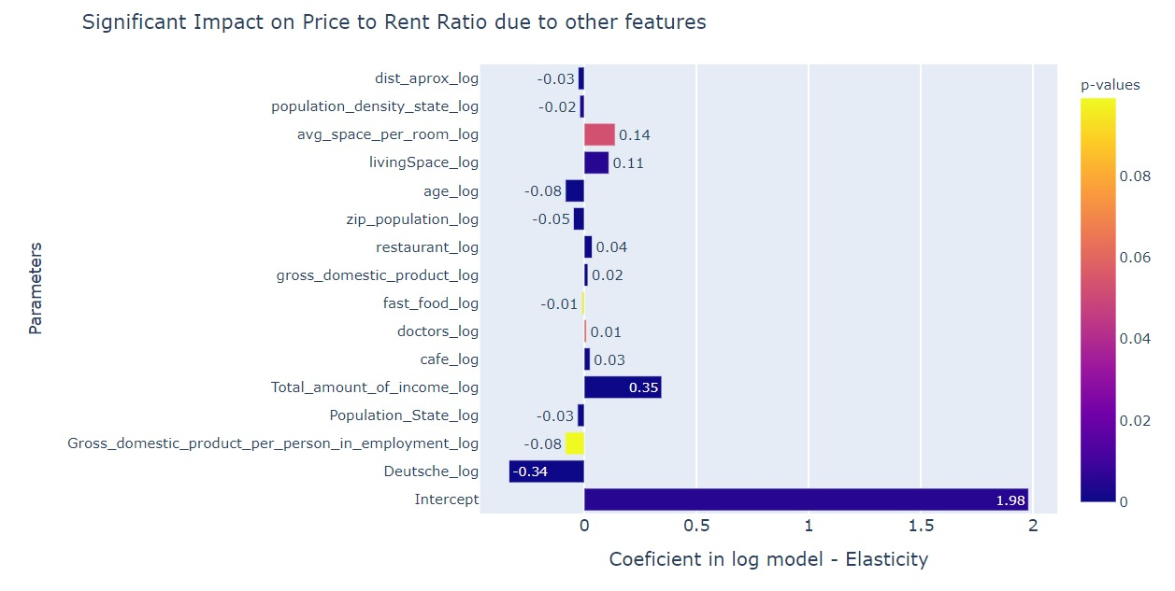
Log-log Models for Elasticity:

Slide 23
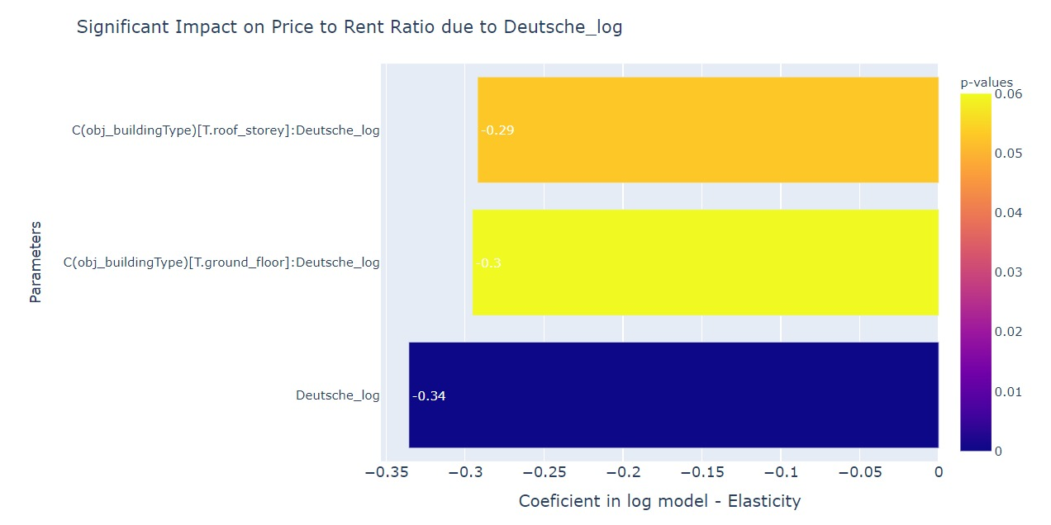
Log-log Models for Elasticity:

Slide 24
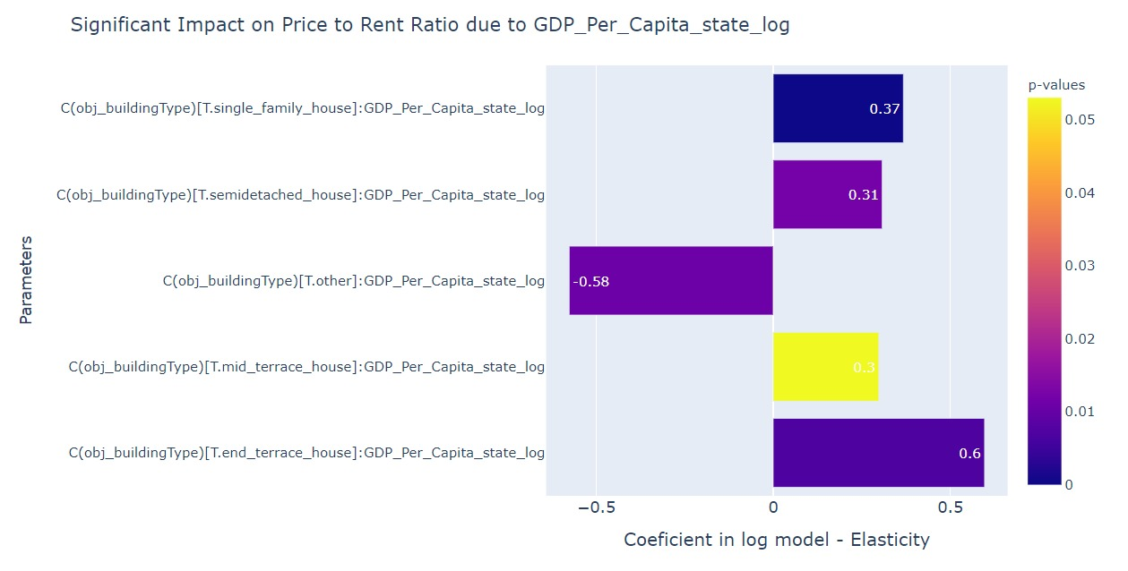
Log-log Models for Elasticity:

Slide 25
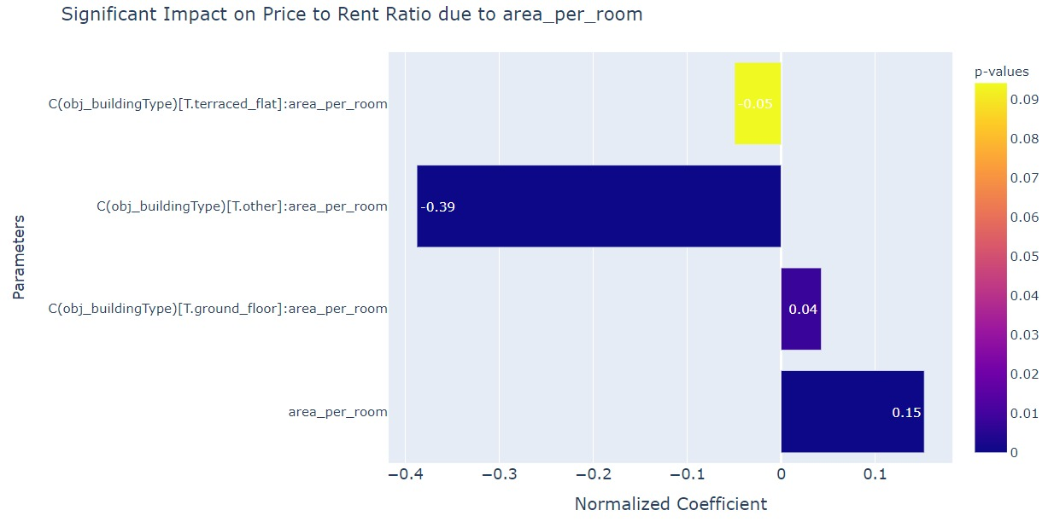
Non-log model: Normalized Coefficients

Slide 26
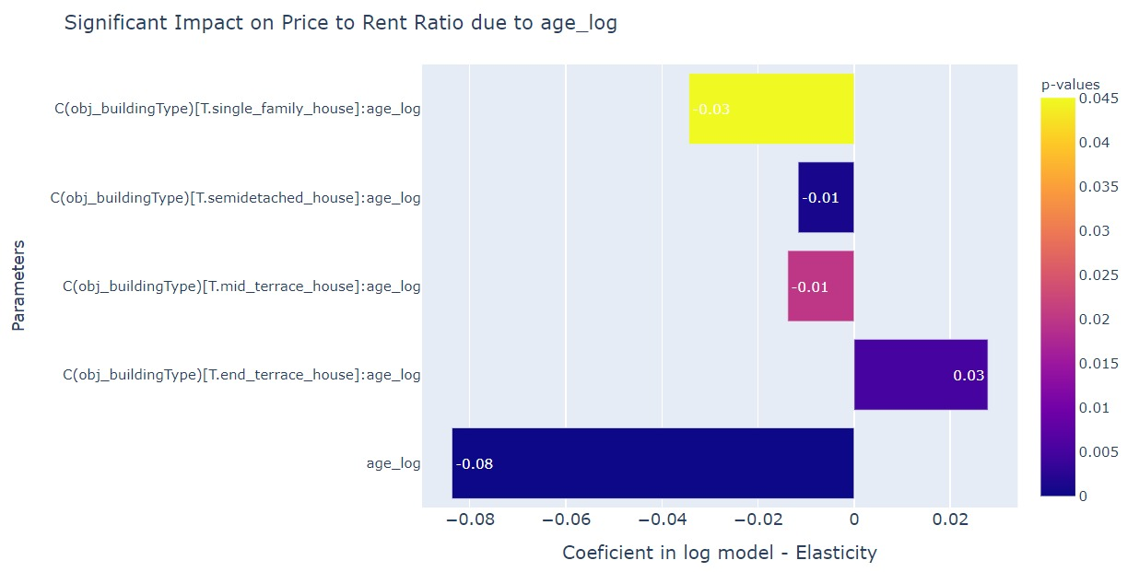
Log-log Models for Elasticity:

Slide 27
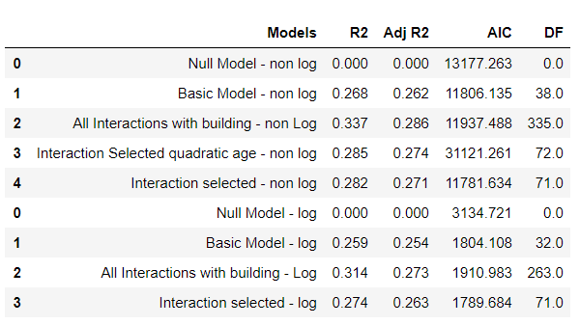
Model comparisons

Slide 28
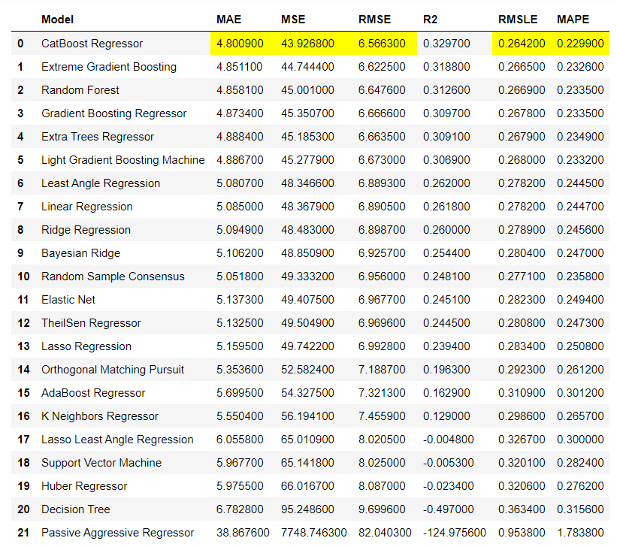
COMPARISON BETWEEN MACHINE LEARNING MODELS:

Slide 29
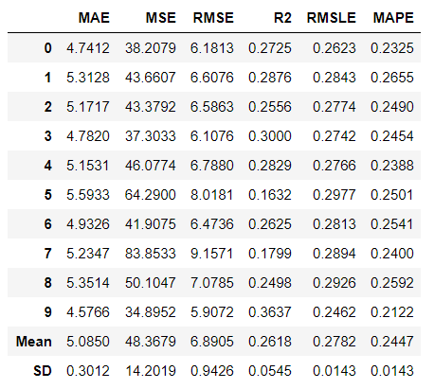
10 CROSS VALIDATION OF LINEAR NON-LOG MODEL

Slide 30
Insights from the Model Visualizations:
East of Germany has a higher Price to Rent ratio, however West of a major city has a higher price to rent ratio.
Fast-food and public transport has a negative impact on price to rent ratio whereas Cafes have a positive impact.
Except for the category involving not so popular house categories, the other house categories show a negative impact on GDP per capita of state.
The building categories (others and terrace flats) have a negative impact on price to rent ratio.
Older end-terraced houses tend to have a higher price to rent ratio.

Slide 31
Future Scope and takeaways:
Future Scope:
More macro data
Building more complex models
Takeaway:
Working on a macro-micro approach
Working on data to take real business decisions
Data scraping
Regression analysis and modelling
Handling heteroscedasticity and multicollinearity
Comparisons between regression analysis and machine learning approaches
Making Interpretable models.
Notes:
More macro data will help understand the impact better
Using timeseries we can forecast the BONNUS, we could get more macro data and collecting data at multiple points in time

Slide 32
References:
https://rspatial.org/raster/analysis/3-spauto.html
https://stats.idre.ucla.edu/other/mult-pkg/faq/general/faq-how-can-i-detectaddress-spatial-autocorrelation-in-my-data/
https://r-spatial.github.io/spdep/reference/lm.morantest.html
https://www.ncbi.nlm.nih.gov/pmc/articles/PMC4723244/
http://rstudio-pubs-static.s3.amazonaws.com/9687_cc323b60e5d542449563ff1142163f05.html

Slide 33
Thank you

